Slide 1
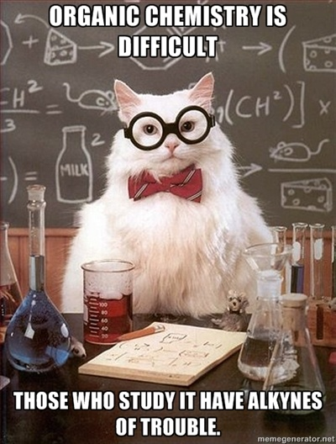
Organic Chemistry

Slide 2
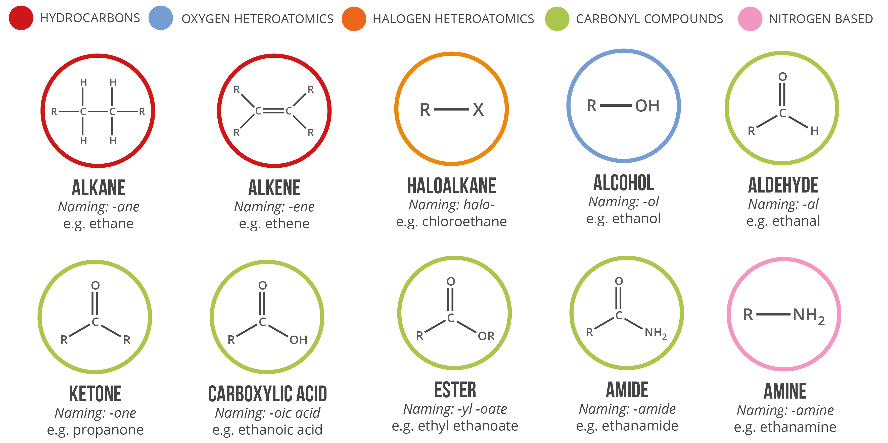
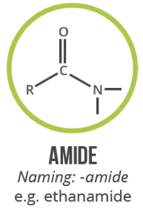
Organic chemistry

Slide 3
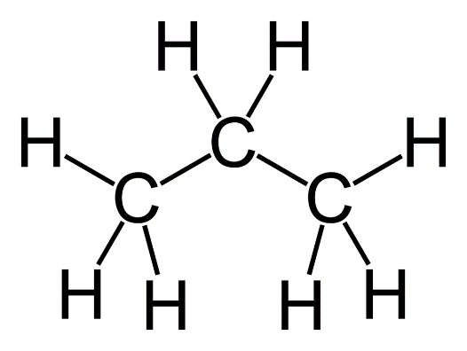
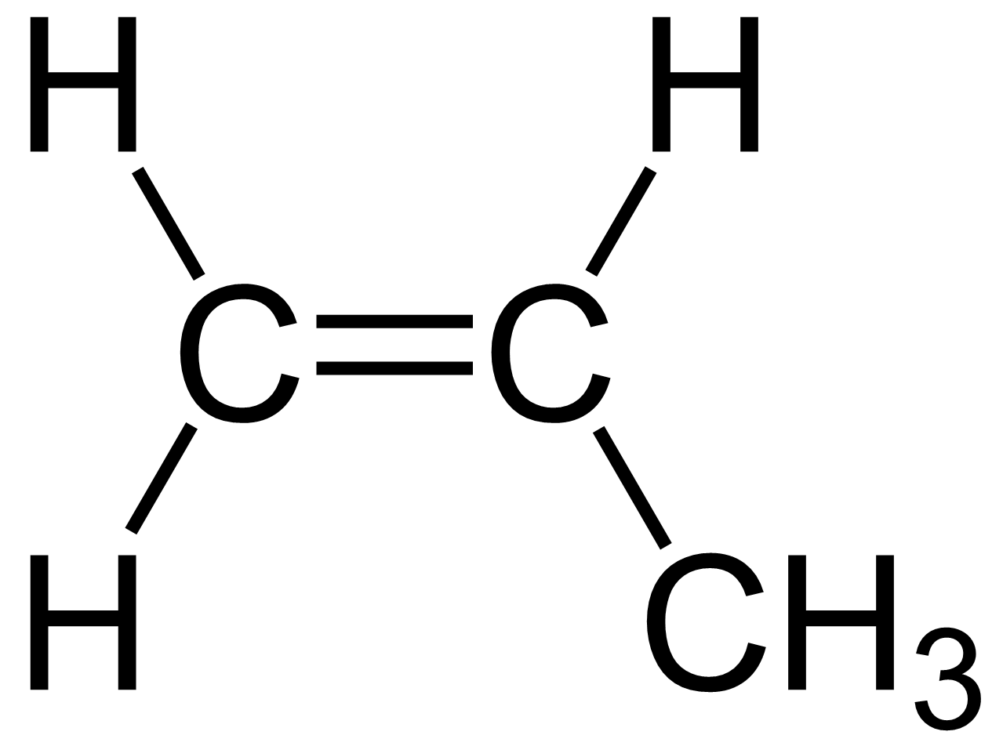
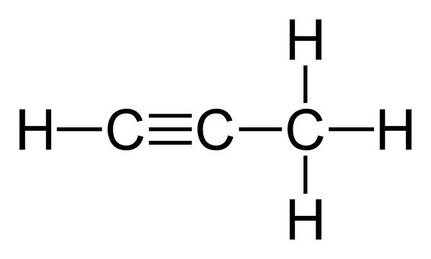
Types of hydrocarbons
Alkanes
Single bonds only
General formula: C_{n}H_{2n+2}
Alkenes
At least one C=C double bond
General formula: C_{n}H_{2n}
Alkynes (not in Year 12 course)
At least one C≡C triple bond
General formula: C_{n}H_{2n-2}
propane (C₃H₈)
propene (C₃H₆)
propyne (C₃H₄)

Slide 4
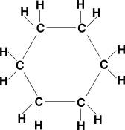
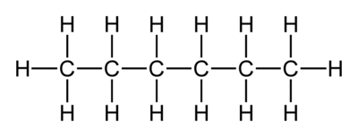
Types of hydrocarbons
Cyclic hydrocarbons
Have carbons in a ring formation
Have two less hydrogens than non-cyclic version (example below…)
cyclohexane (C₆H₁₂)
hexane (C₆H₁₄)

Slide 5
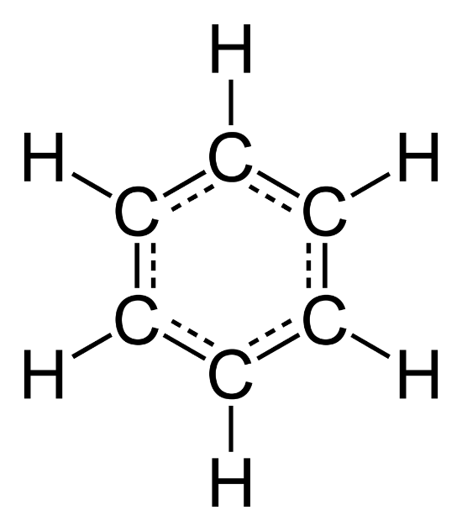
Classifying hydrocarbons
Aliphatics: Open chain (non-cyclic) hydrocarbons
Alicyclics: Cyclic hydrocarbons
Aromatics: Contain benzene
Saturated: Possesses only single C-C bonds
Unsaturated: Possesses double or triple bonds
benzene (C₆H₆)

Slide 6
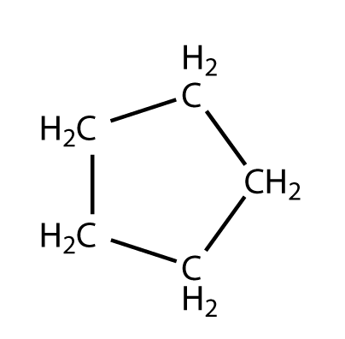
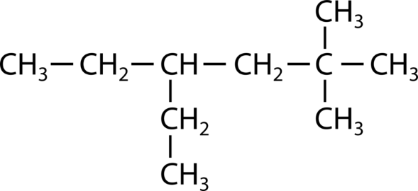
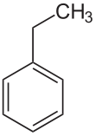
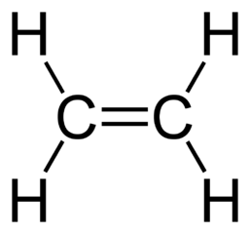
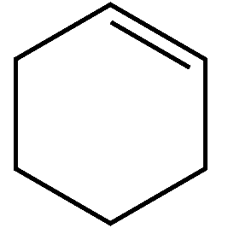
Classifying hydrocarbons - Examples
NON-AROMATIC
Saturated aliphatic
Saturated alicyclic
AROMATIC
3-ethyl-5,5-dimethylhexane
cyclopropane
Unsaturated aliphatic
Unsaturated alicyclic
ethylbenzene
ethene
cyclohexene

Slide 7
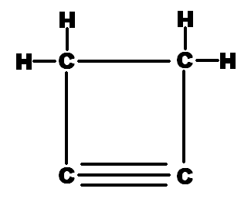
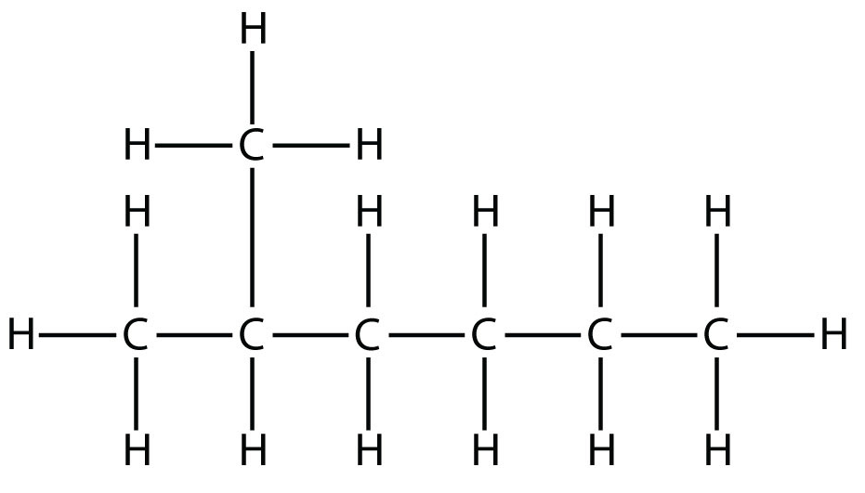
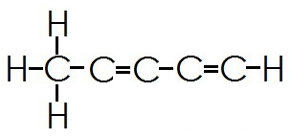
Over to you…
Use the above terms to classify each of the following hydrocarbons:
unsaturated aliphatic
unsaturated alicyclic
saturated aliphatic

Slide 8
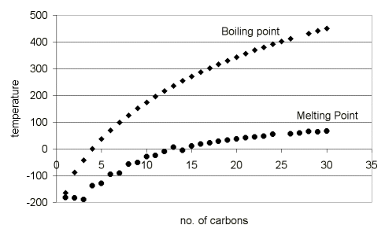
Physical properties of hydrocarbons
Which alkanes are:
Gases at room temp?
Liquids at room temp?
Solids at room temp?
C₁ to C₄
C₅ to C_{16-20ish}
> C_{20ish}

Slide 9
Physical properties of hydrocarbons
Explain why:
Alkanes have a generally low melting and boiling points
The melting and boiling point of alkanes increase as the length of the carbon chain increases

Slide 10
Isomers
Same molecular formula but different structure or orientation of atoms.
Has affects on physical and chemical properties of molecules.

Slide 12
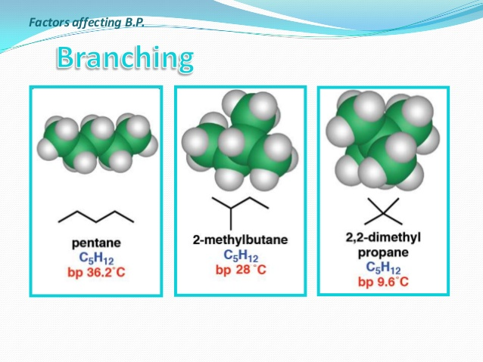
Isomers – Effect on properties
Q: Explain the difference in boiling point between pentane and 2,2-dimethylpropane
A: The difference in boiling point is due to pentane having stronger dispersion forces than 2,2-dimethylpropane. The linear shape of pentane molecules allow them to pack closer together and share a larger surface area than 2,2-dimethylpropane molecules. As a result the dispersion forces are stronger and more energy is needed to separate the molecules.

Slide 13
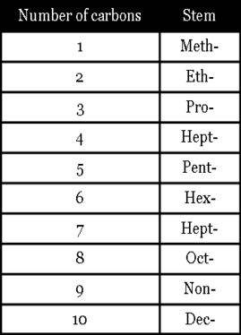
Naming Alkanes
MAIN CHAIN:
Find the longest chain
Name the longest chain and give the suffix ‘-ane’
SIDE CHAINS:
Identify and name any side groups
Place the side groups in alphabetical order
Add prefixes to side groups (di-, tri-, tetra-)
Number the chain so side groups have the lowest number
But-

Slide 14
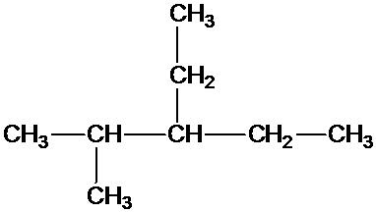
Naming Alkanes

Slide 15
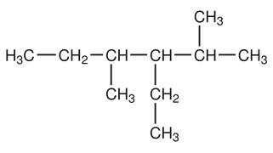
Naming Alkanes

Slide 16
Naming alkenes
Similar to alkanes, but has the suffix –ene.
H₂C=CH₂ H₂C=CHCH₃
ethene propene
H₂C=CH₂CH₂CH₃ CH₃CH=CHCH₃
but-1-ene but-2-ene
OR 1-butene OR 2-butene
Number represents the carbon in the chain where the double bond starts. Carbons are numbered to give the double bond the lowest number.

Slide 17
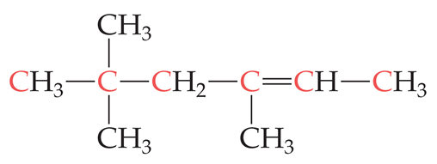
Naming alkenes

Slide 18
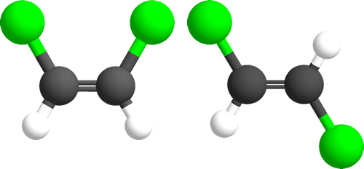
Geometric isomers
Occur in alkenes that have different groups on either side of the double bond
Double bonds cannot rotate, so the below molecules are different isomers
Transport
Transaction
Transcribe
Translate
Transplant
Transmit
Transfer
cis-1,2-dichloroethene
trans-1,2-dichloroethene
Let’s learn Latin! cis: ‘on this side of’ trans = ‘across’

Slide 19
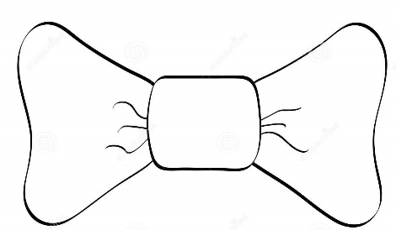
Geometric isomers
To show cis/trans isomers, draw your molecules like a bowtie with the double bond drawn horizontally
H
CH₃
H
H
C=C
C=C
CH₃
C=C
H
CH₃
H
CH₃
CH₃
H
CH₃
trans-but-2-ene
cis-but-2-ene
but-2-ene
Ambiguously drawn – could be either isomer

Slide 20
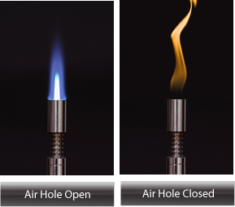
Combustion reactions
All hydrocarbons (alkanes and alkenes) burn in oxygen.
The products of complete combustion (where there is an excess of O₂) are H₂O and CO₂.
C₈H₁₆ + 12 O₂ → 8CO₂ + 8 H₂O
Incomplete combustion occurs if there is a limited supply of O₂. Carbon monoxide gas or C (soot) may be produced instead of CO₂.
C₈H₁₆ + 4 O₂ → 8 C + 8 H₂O

Slide 21
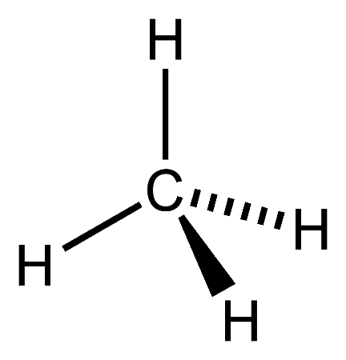
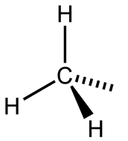
Substitution Reactions
Alkanes can do substitution with halogens in the presence of UV light.
UV
+ Cℓ–Cℓ
Cℓ
+ H–Cℓ
methane
chlorine
chloromethane
hydrogen chloride

Slide 22
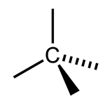
Substitution Reactions
If there is an excess of halogen then substitution can happen multiple times.
Cℓ
UV
+ 4 Cℓ–Cℓ
Cℓ
+ 4 H–Cℓ
Cℓ
Cℓ
methane
chlorine
tetrachloromethane
hydrogen chloride

Slide 23
Substitution Reactions
Name the most predominant organic product of the following reactions:
Ethane and fluorine are added in a 1:1 mole ratio ____________________________
Ethane is added to an excess of fluorine ____________________________
Fluorine is added to an excess of ethane ____________________________
fluoroethane
hexafluoroethane
fluoroethane

Slide 24
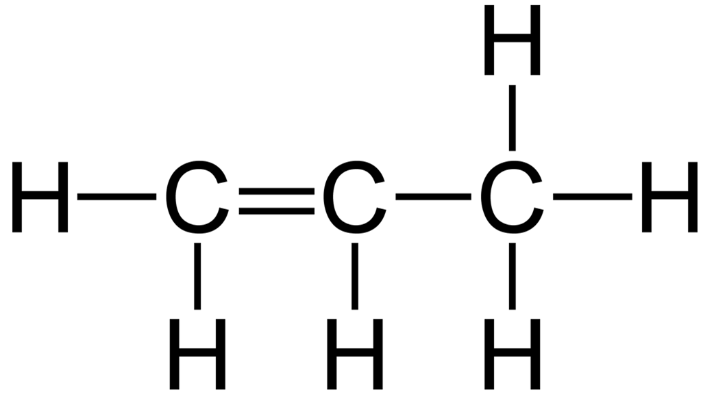
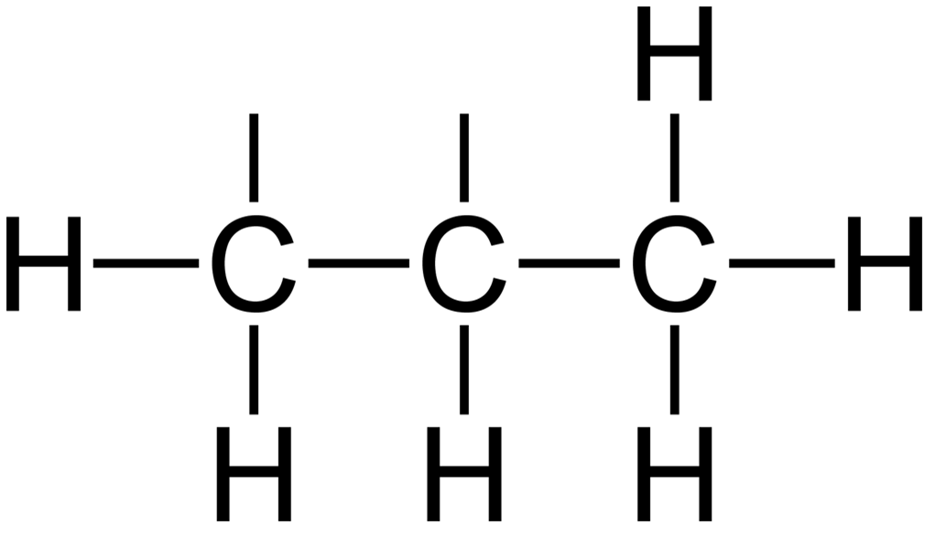
Addition Reactions
Alkenes can do addition reactions with various substances. The double bond breaks and atoms are added to each carbon.
Halogenation:
Cℓ
Cℓ
+ Cℓ–Cℓ
propene
chlorine
1,2-dichloropropane
Note: 1,2-dichloropropane can also undergo substitution if there is UV light and excess Cℓ₂!!

Slide 25
Addition Reactions
Alkenes can do addition reactions with various substances. The double bond breaks and atoms are added to each carbon.
Hydrogenation:
H
H
+ H–H
Ni
propene
hydrogen
propane

Slide 26
Addition Reactions
Hydration:
OH
H
H
OH
+ H–O–H
H₂SO₄
OR
propene
water
propan-1-ol
propan-2-ol

Slide 27
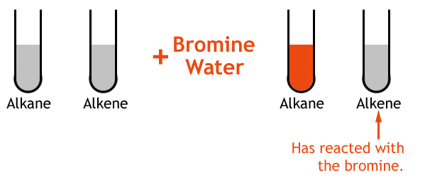
Chemical tests for alkanes and alkenes
Addition reactions with Br₂ can be a way to chemically distinguish between alkanes and alkenes.
Addition of Br₂ to the alkene will cause the reddish-brown colour of the solution to fade quickly.

Slide 28
Reaction flowchart
Haloalkanes
Substitution with halogen
Addition with halogen
Alkanes
Alkenes
Alcohols
Addition with H₂
Addition with H₂O

Slide 29
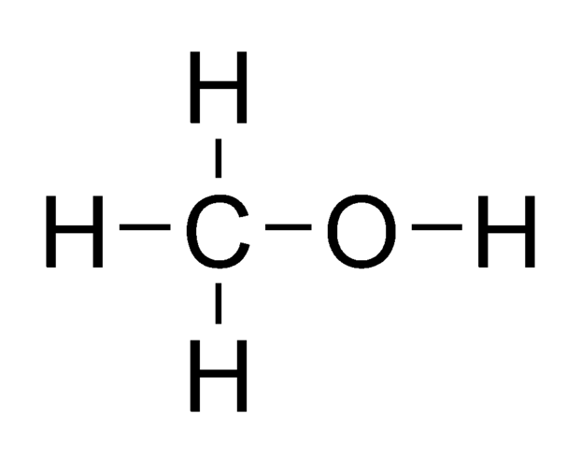
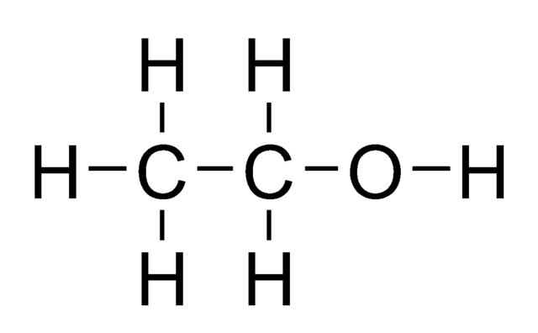
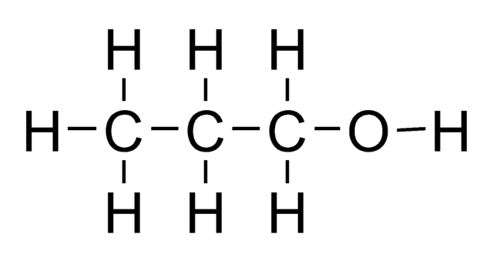
Functional groups
Hydrocarbons are just one type of organic molecule. Other families of organic molecules are classified based on the presence of shared chemical structures or functional groups.
For example, alcohols contain a hydroxyl functional group (–OH):
The –OH group in alcohols influences the physical and chemical properties of these molecules compared to similar length alkanes.
methanol
ethanol
propan-1-ol

Slide 30
Functional groups
Some important functional groups:
You will need to start learning to recognise these groups. We will learn more about each type throughout the course.

Slide 31
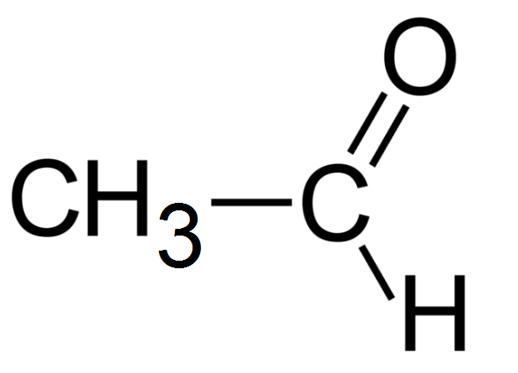
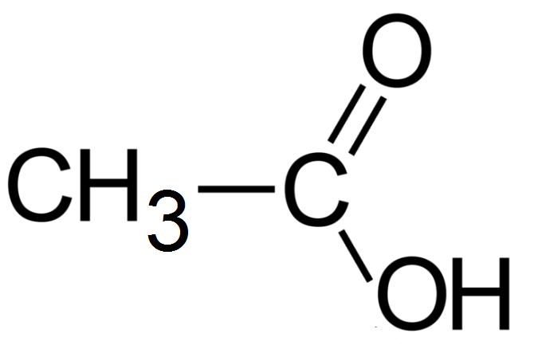
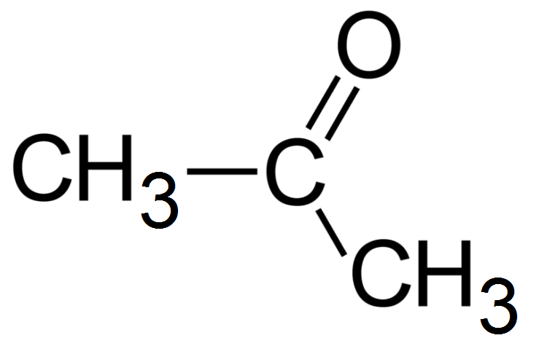
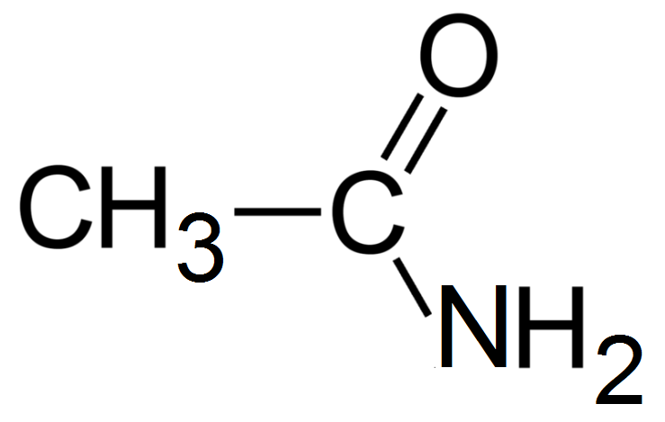
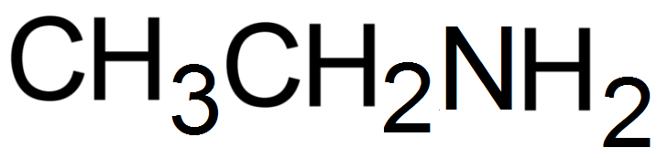
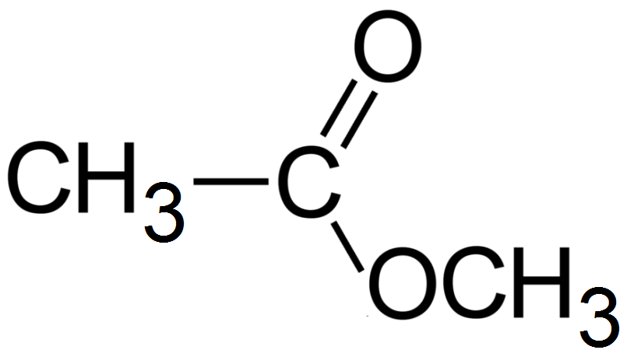
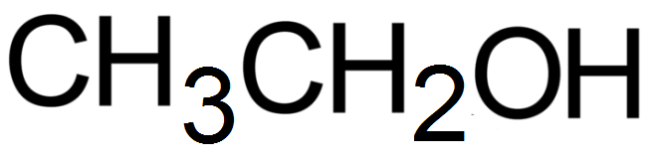
Identifying functional groups
aldehyde
carboxylic acid
ketone
amide
amine
ester
alcohol

Slide 32
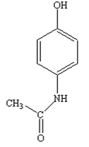
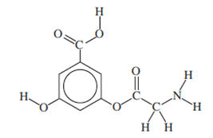
alcohol
carboxylic acid
amine
amide
alcohol
ester

Slide 33
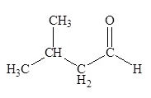
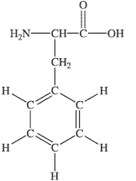
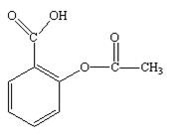
aldehyde
carboxylic acid
carboxylic acid
amine
ester

Slide 34
2007 TEE Exam:
alcohol
carboxylic acid
amine

Slide 35
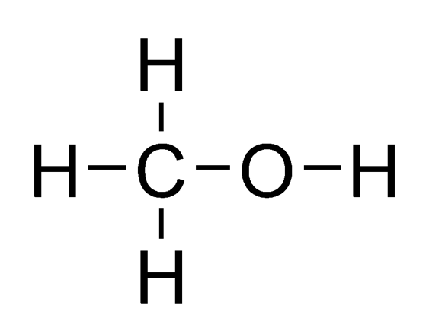
Alcohols
Functional group: R-OH
Naming:
Choose the longest carbon chain that is connected to the OH group
Name the longest chain, replacing the last ‘e’ with the suffix ‘ol’
Methane → Methanol
Hexane → Hexanol
To show position of the alcohol group, number carbon chain so that OH group is connected to the carbon with the lowest number.
If there are multiple OH groups then use the suffixes like ‘-diol’, ‘-triol’, etc. and keep the ‘e’. e.g. butane-2,3-diol
methanol
ethanol

Slide 36
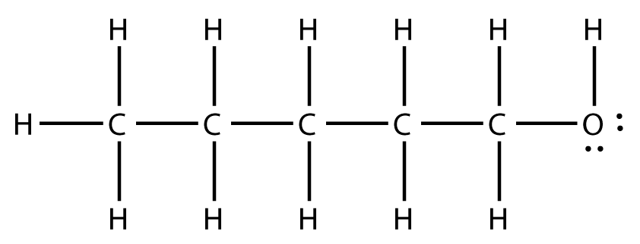
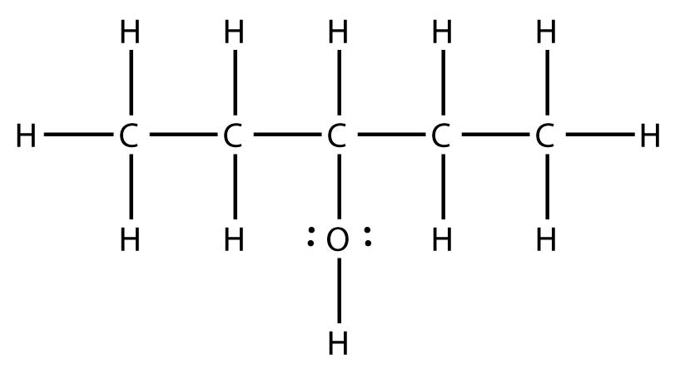
Alcohols
pentan-1-ol
pentan-3-ol

Slide 37

Alcohols
The dotted line in this example shows the longest chain that includes the –OH group.
This is used as the main chain, even though there is a longer carbon chain in the molecule.
2-ethylpentan-1-ol

Slide 38
Alcohol – Naming questions
Structure | Name
CH₃CH₂CH₂OH
CH₃CHCH₂CHCH₃ | | OH Cℓ
CH₂OHCH₂CH₂CH₂OH
 | propan-2-ol (rubbing alcohol)
 | ethane-1,2-diol (antifreeze)
 | 5-bromopentan-1-ol
propan-1-ol (or 1-propanol)
4-chloropentan-2-ol (or 4-chloro-2-pentanol)
butane-1,4-diol (or 1,4-butanediol)
CH₃–CH–CH₃
|
OH
CH₂–CH₂–OH
|
OH
CH₂–CH₂–CH₂–CH₂–CH₂Br
|
OH

Slide 39


Aldehydes
Functional group:
(also written as –CHO)
Naming:
Choose the longest carbon chain including the CHO group
Name the longest chain, replacing the last ‘e’ with the suffix ‘al’
Methane → Methanal
Hexane → Hexanal
Number the carbon chain so that the –CHO group starts from carbon #1. You do not need to show the position of the group in the compound’s name because (by definition) it will be at carbon #1.
methanal
ethanal

Slide 40


Ketones (pronounced ‘key-tones’)
Functional group:
Different to an aldehyde in that the C=O occurs in the middle of a chain
Naming:
Choose the longest carbon chain including the CO group (‘carbonyl group’)
Name the longest chain, replacing the last ‘e’ with the suffix ‘one’
Butane → Butanone
Hexane → Hexanone
Number the carbon chain so that the C=O group has the lowest number. If necessary show the position of the double ketone group. e.g. heptan-2-one
propanone

Slide 41
Structure | Name
CH₃CH₂CH₂CCH₃ || O
CH₂CℓCHO
CH₃CH₂CH₂CHCHO | CH₃
 | 3-methylbutanal
 | 5-methylhexan-3-one
pentan-2-one (or 2-pentanone)
2-chloroethanal
2-methylpentanal
O
||
CH₃–CH₂–CH₂–C–H
|
CH₃
O
||
CH₃–CH₂–C–CH₂–CH₂–CH₃
|
CH₃

Slide 42



Carboxylic acids
Functional group:
Also written as –COOH (at end) or HOOC– (at start)
Naming:
Choose the longest carbon chain including the COOH group
Name the longest chain, replacing the last ‘e’ with the suffix ‘oic acid’
Methane → Methanoic acid
Hexane → Hexanoic acid
Number the carbon chain so that the –COOH group starts from carbon #1. You do not need to show the position of the group in the compound’s name because (by definition) it will be at carbon #1.
methanoic acid
ethanoic acid

Slide 43

Carboxylic acids
5
4
3
2
1
methylpropanoic acid
3-methylbutanoic acid

Slide 44
Structure | Name
 | pentanoic acid
 | 4-chloroheptanoic acid
O || CH₃–CH–CH₂–CH₂–CH₂–C–OH | CH₃
HOOCCH₂CH₂Br
O
||
CH₃–CH₂–CH₂–CH₂–C–OH
Cℓ O
| ||
CH₃–CH₂–CH₂–CH–CH₂–CH₂–C–OH
5-methylhexanoic acid
3-bromopropanoic acid

Slide 45
Revision – Naming alcohols, aldehydes, ketones, carboxylic acids
Questions in workbook.

Slide 46


Functional Groups & Properties
Because alcohols contain –OH groups hydrogen bonding occurs between neighbouring molecules. As a result, alcohols have relatively high melting points and boiling points compared with hydrocarbons of similar molecular mass. Alcohols also tend to dissolve readily in water, although their solubility decreases with increasing length of the hydrocarbon chain.
Hydrogen bonding in liquid methanol Hydrogen bonding between methanol and water

Slide 47


Functional Groups & Properties
The C=O groups in aldehydes and ketones are polar as the oxygen atoms are more electronegative than carbon atoms. The bonding electrons spend more time in the vicinity of the oxygen atom, leaving the carbon atom slightly deficient in electrons.
Because aldehydes and ketones are polar, dipole-dipole forces exist between their molecules. These intermolecular forces are stronger than the dispersion forces between hydrocarbon molecules. As a result, aldehydes and ketones have higher boiling points than hydrocarbons of similar molecular mass. The boiling points of aldehydes, however, are lower than those of alcohols in which hydrogen bonding is present.
Even though there is no hydrogen bonding between molecules of aldehydes or ketones, they are still able to form hydrogen bonds with molecules such as water. In this case the hydrogen bond forms between the δ⁺ H from the water molecule and the lone electrons on the oxygen atom from the ketone or aldehyde.

Slide 48

Functional Groups & Properties
Because of the presence of the OH and C=O groups, carboxylic acids can form strong hydrogen bonds. As a result, carboxylic acids possess higher melting points, boiling points and densities than almost all other organic compounds of similar size and molecular mass. The smaller carboxylic acids are very soluble in water but the solubility decreases as the size of the hydrocarbon chain increases.
Carboxylic acids (as their name implies) are also acidic. They ionise in solution, losing the hydrogen from the -COOH group to form a –COO⁻ ion.
CH₃COOH + H₂O ⇌ CH₃COO⁻ + H₃O⁺

Slide 49
Classification of alcohols
Alcohols can be classified as primary, secondary or tertiary based on the position of the OH group.
H
1º
C
2º
C
3º
–
–
–
–C–OH
C–C–OH
C–C–OH
–
–
–
H
H
C

Slide 50

Classification of alcohols
Diagram
Name
Type of alcohol
2-methylbutan-2-ol
tertiary

Slide 51

Classification of alcohols
Diagram
Name
Type of alcohol
3-methylbutan-1-ol
primary

Slide 52

Classification of alcohols
Diagram
Name
Type of alcohol
propan-2-ol
secondary

Slide 53

Classification of alcohols
Diagram
Name
Type of alcohol
butan-1-ol
primary

Slide 54

Classification of alcohols
Diagram
Name
Type of alcohol
pentan-3-ol
secondary

Slide 55

Classification of alcohols
Diagram
Name
Type of alcohol
2-methylpropan-2-ol
tertiary

Slide 56
Physical properties of alcohols (cont.)
The strength of hydrogen bonding in alcohols depends on the extent to which the –OH group is exposed and available for bonding. The –OH group is most exposed in primary alcohols and least exposed in tertiary alcohols. Hence, while all three classes of alcohols exhibit some common properties there are differences in both their physical and chemical properties. For example, primary alcohols have higher boiling points than secondary alcohols which in turn have higher boiling points than tertiary alcohols.
Question:
Given that the chain branching lowers the boiling points of compounds and decreases the accessibility of the –OH group for hydrogen bonding, draw the structures of four isomeric alcohols with molecular formula C₄H₁₀O and match these structures with the boiling points of 83 °C, 100 °C, 108 °C and 118 °C. Justify your choice for the relative order you have assigned.
Hint: Start by figuring out what the four isomers are!!

Slide 57
Physical properties of alcohols (cont.)
Question:
Given that the chain branching lowers the boiling points of compounds and decreases the accessibility of the –OH group for hydrogen bonding, draw the structures of four isomeric alcohols with molecular formula C₄H₁₀O and match these structures with the boiling points of 83 °C, 100 °C, 108 °C and 118 °C. Justify your choice for the relative order you have assigned.
Hint: Start by figuring out what the four isomers are!!

Slide 58

Reactions of alcohols – Oxidation

Slide 59


Esters
Functional group:
(also written as –COO–)
Esters are an important group of organic compounds found in a wide range of biological systems. They include vegetable and animal oils and fats, natural waxes and a range of natural flavours and fragrances.
Esters are similar to carboxylic acids except that an alkyl group is attached to the oxygen atom rather than a hydrogen atom.
propyl ethanoate

Slide 60

Reactions that produce esters
Esters are formed from the reaction between an alcohol and a carboxylic acid.
During this process the OH from the carboxylic acid and the H from the alcohol join to form water. The leftover molecules join to form an ester.
The reaction is acid catalysed and is a reversible reaction.
Reactions that produce esters are called esterification reactions. You can also describe this reaction as a condensation reaction because water is produced as a by-product.

Slide 61

Naming esters
Esters have a two part name:
The first part is derived from the name of the alcohol precursor and has the suffix –yl
The second part is derived form the name of the carboxylic acid precursor and has the suffix –oate
Confused about which part is which? The ‘–oate’ part (from the carboxylic acid) will be the part that starts from the C=O.

Slide 62


Naming esters
O
O
O
=
=
=
CH₃ – C — O – CH₃
CH₃ – CH₂ – C — O – CH₃
CH₃ – CH₂ – CH₂ – C — O – CH₂ – CH₃
methyl ethanoate
(methyl acetate)
methyl propanoate
ethyl butanoate
CH₃COOCH₂CH₃
ethyl ethanoate
(ethyl acetate)
O
=
CH₃ – O — CH
CH₃CH₂CH₂OOCCH₃
methyl benzoate
methyl methanoate
propyl ethanoate
Note: is benzoic acid

Slide 63


Slide 64
Properties of esters
Intermolecular forces:
Combination of dispersion forces and dipole-dipole forces
Boiling Point / Melting point:
Usually liquid at room temperature
Lower MP/BP than alcohols and carboxylic acids with similar molecular weight (no hydrogen bonding)
Solubility:
Small esters are soluble in water (form hydrogen bonds with water molecules)
Solubility rapidly decreases as chain length increases

Slide 65

Properties of esters
Odour:
Many volatile esters have a ‘fruity’ odour. These compounds are naturally generated by fruit and gives them their characteristic odours.
Esters are commonly used as natural flavours and fragrances. For example, fake banana lollies may contain pentyl ethanoate to simulate the smell of a banana.
A fruity odour is a key observation that an ester has been produced in a chemical reaction.
Q: Give a full set of observations for the reaction between butanol and ethanoic acid in the presence of an acid catalyst
A: Two colourless liquids are mixed. The resulting mixture has a fruity odour.

Slide 66



Reactions of esters
Hydrolysis:
As mentioned previously, esterification reactions are reversible. The reverse reaction is a hydrolysis reaction as it involves the addition of water (c.f. hydrolysis of alkenes)
In acid conditions…
H⁺
+ H₂O ⇌
+
ethyl ethanoate
ethanoic acid
ethanol
ester
carboxylic acid
alcohol

Slide 67

Reactions of esters
In basic conditions…
Similar to acidic conditions, but the hydroxide removes the acidic proton from the carboxylic acid.
+ OH⁻ ⇌
+
ethyl ethanoate
ethanoate ion
ethanol
ester
carboxylate ion
alcohol

Slide 68


Slide 69
ORGANIC REACTIONS – PRACTICE QUESTIONS
Questions in workbook

Slide 70




Amines
Functional group: R-NH₂
Naming:
Choose the longest carbon chain including the NH₂ group
Name the longest chain, replacing the last ‘e’ with the suffix ‘amine’
Number the carbon chain so that the NH₂ group has the lowest number.
methanamine
ethanamine
butan-1-amine
butan-2-amine

Slide 71


Slide 72
Properties of amines
Amines can form hydrogen bonds due to the presence of polar N-H bonds within the molecules. Hydrogen bonds formed by amines are weaker than the hydrogen bonding that exists in alcohols because nitrogen is less electronegative than oxygen. As a result, boiling points of amines are lower than similarly sized alcohols.
Boiling point trends: Hydrocarbons < Aldehydes/Ketones/Esters < Amines < Alcohols < Carboxylic acids
dispersion dispersion + dipole-dipole dispersion + dipole-dipole + hydrogen bonding
Odour: ‘Fishy’ or ‘foul-smelling’ odour. (Volatile amines are produced during animal decomposition)
Basic: A key feature of amines is their ability to act as bases in the same manner as ammonia. Amines can act as proton acceptors as shown in the following equation:
RNH₂ + H⁺ ⇌ RNH₃⁺

Slide 73


Slide 74


Slide 75





Slide 76

Amino acids
Amino acids are molecules which have an amine group AND a carboxylic acid group.
glycine

Slide 77


Amino acids
Amino acids can be classified based on how many carbons separate the two groups.
γ carbon
β carbon
α carbon
β carbon
α carbon
γ-amino acid
(gamma-amino acid)
β-amino acid
(beta-amino acid)

Slide 78




α-Amino acids
α-Amino acids are acids where the NH₂ group and the COOH group are both attached to the same carbon atom (the α carbon).
α-Amino acids are essential chemicals in biological systems. Proteins and enzymes are composed of very large series of chemically-bonded α-amino acids.
Glycine (shown earlier) is the simplest α-amino acid.
α-amino acid

Slide 79

Chemistry of amino acids
Properties are heavily influenced by the presence of the NH₂ and COOH groups
NH₂groups are basic – accept protons
COOH groups are acidic – donate protons
In the neutral state, the COOH group donates protons to the NH₂ group, producing COO⁻ and NH₃⁺
Molecules that have both positive and negative charges like this are called zwitterions. All amino acids in the solid state and in aqueous solutions adopt this form.

Slide 80
Chemistry of amino acids
Properties:
How would the zwitterion form affect bonding within solid amino acids?
What would their melting points and boiling points be like?
How would the zwitterion form affect solubility of amino acids in polar solvents (e.g. water)?
How would the zwitterion form affect solubility of amino acids in non-polar solvent?

Slide 81


Chemistry of amino acids
a) Redraw serine (below) as a zwitterion.
serine
serine (zwitterion)

Slide 82

Chemistry of amino acids
b) Serine exists as a zwitterion in neutral solutions. Write an equation showing what happens to serine when the pH of the solution is lowered (more acidic).
+ H⁺ ⇌
serine (zwitterion)
serine (protonated)

Slide 83

Chemistry of amino acids
c) Write an equation showing what happens to serine when the pH of the solution is made basic.
+ OH⁻ ⇌
serine (zwitterion)
serine (deprotonated)

Slide 84
Chemistry of amino acids
d) Apply your understanding from the previous three questions to answer this past exam question.
The structure for the α-amino acid alanine is shown below. Redraw the structure for alanine under acidic, neutral and basic conditions.
Structure in acidic pH | Structure in neutral pH | Structure in basic pH

Slide 85

Chemistry of amino acids

Slide 86

Reactions of amino acids
Condensation reactions:
Carboxylic acids react with amines to produce an amide and water.

Slide 87


Reactions of amino acids
Amino acids have both functional groups, so the carboxylic acid of one molecule can react with the amine group of another.
The functional group joining both molecules ( ) is called an amide.
In biological systems, this group is referred to as a peptide link. Two amino acids joined is a dipeptide.
+

Slide 88


Slide 89
Polypeptides (proteins)
A polypeptide is a long chain of many amino acids joined by peptide bonds. The 20 amino acids can combine in many different ways to make millions of different polypeptides.
Proteins are usually made of one polypeptide chain (although some proteins have more than one). The number and sequence of the amino acids determines the properties of the protein and this affects its functions.

Slide 90


Slide 91


Slide 92

Protein Shape and Structure
The function of proteins and enzymes is related to their shape, which can be quite complex.
The shapes of these molecules depends on intermolecular forces between different functional groups on the polypeptide chains.
The structure of a protein can be understood on a number of levels:
Primary structure
Secondary structure
Tertiary structure
Quaternary structure *Not in syllabus

Slide 93

Primary structure
The primary structure refers to the number and sequence of amino acids in the polypeptide chain. The amino acids are joined by covalent bonds (very strong).

Slide 94

Secondary structure
The different parts of the polypeptide chain attract each other due to hydrogen bonds between the different parts of the polypeptide chains. This can lead to two different formations:
Alpha helix (α-helix)
In this structure, the polypeptide is twisted into a spiral. There are hydrogen bonds between the C=O group of one part of the chain and the –NH group from another part.

Slide 95

Secondary structure
Beta pleated sheet (β-pleated sheet)
In this structure two different parts of polypeptide chain are aligned adjacent to each other. There are hydrogen bonds between C=O groups and –NH groups.

Slide 96


Slide 97

Secondary structure
Physical properties:
The alpha helix shape can lead to proteins that are elastic and stretch. e.g. elastin in elastic connective tissues of the body.
The beta-pleated shape produces a protein that is flexible but not elastic. e.g. keratin in silk.
Note: An individual protein can have different sections of alpha helixes and beta-pleated sheets.

Slide 98
Tertiary Structure
The polypeptide undergoes further folding and curling to form of the overall 3D structure.
This is caused by interactions between the side-chains from the amino acids (the ‘R’ groups).

Slide 99

Tertiary Structure
Ionic Bond:
When two oppositely charged R groups are near each other they can form an ionic bond

Slide 100

Tertiary Structure
Hydrogen bond:
If side chains contain –OH or –NH groups then hydrogen bonds could be formed between the side chains.

Slide 101

Tertiary Structure
Dispersion force:
Some amino acids have large hydrocarbon groups with significant dispersion forces. These side chains could attract each other through dispersion forces.

Slide 102


Tertiary Structure
Disulfide bridges:
Disulfide bridges are covalent bonds that form between the sulfur atoms of nearby cysteine molecules. These bonds are very strong.

Slide 103


Slide 104

Quarternary Structure
This refers to the ways proteins with two or more polypeptide chains fit their chains together.

Slide 105
Shape and Function
The shape of proteins determines their function.
“The protein folding problem: a major conundrum of science: Ken Dill at TEDxSBU” https://www.youtube.com/watch?v=zm-3kovWpNQ

Slide 106

Denaturing proteins
Proteins can become denatured and loss function depending on their environment.

Slide 107
Denaturing proteins
Heat can disrupt dispersion forces and hydrogen bonds
pH can affect ionic bonds. Can protonate COO⁻ group or deprotonate NH₃⁺ group.
Intermediate pH
Low pH (high acidity)
Protonated COO⁻ group is no longer negatively charged
O
O
||
||
-CH₂CH₂-C-OH
-CH₂CH₂-C-O⁻
⁺H₃N-CH₂CH₂CH₂CH₂-
⁺H₃N-CH₂CH₂CH₂CH₂-
Ionic bond

Slide 108
Denaturing proteins
Reducing agents chemically react with disulfide bridges, converting them back to thiol groups (-SH)
Oxidised form (disulfide bridge present)
Reduced form (thiol groups present)
– CH₂ – S –
S – CH₂ –
– CH₂ – S – H
H – S – CH₂ –

